Slide 1



Background Processing
Hangfire v Microsoft Logic Apps
Notes:
Background Processing…
Hangfire and Microsoft Logic Apps
This is a pretty simple topic, but I was kind of surprised, I learnt shit.
Hangfire doesn’t really have a logo so I made one.

Slide 2


Joel Viney
Software developer for 20 years
Developing Azure on and off 4 years
Team Lead at QuillGroup
My work involves lots of Integration, Batch Processing.
https://github.com/JoelViney
Notes:
I’ve been developing professional for 20+ years
Dabbled with Azure on and off for 4 years
QuillGroup Accounting, Financial Planning and Superannuation services in Southport and Brisbane
Currently our solutions have to integrate with:
AbnLookup, ASIC company search, Jira, Bank Codes, Box (google drives awkward step brother), Class, DocuSign, Email Service, IntegraPay, Salesforce, SuperFundLookup, Xero and Xero Practice Manager.
This might not be super-relevant right now, but you get the point.
This is my Github profile link. It includes this presentation and not enough other stuff to impress employers…
I skipped the wedding profile photo this time… I really hate that photo but at least you guys are not going to bag me out for putting up a wedding photo.

Slide 3

Background Processing
Azure Scheduler
“Azure Scheduler will retire on September 30, 2019”
Azure Logic Apps
“Azure Logic Apps is a cloud service that helps you automate and orchestrate tasks, business processes, and workflows when you need to integrate apps, data, systems, and services across enterprises or organizations”
Hangfire
“An easy way to perform background processing in .NET and .NET Core applications. No Windows Service or separate process required. Backed by persistent storage. Open and free for commercial use.”
Other Options? E.g. Quartz?
Notes:
Background processing, background jobs, scheduled tasks, cron jobs what ever you want to call them...
Newsflash, Azure Scheduler is dead. As the end of September Microsoft are killing it. A bit like the windows phone. They are taking it out the back of Redmond and shooting it.
So if anyone liked it, why?... and I’m sorry for your loss.
So where does that leave us?
I am going to do this by going over two products in the industry right now that seem like the obvious choices.
Azure Logic Apps
“Azure Logic Apps is a cloud service that helps you automate and orchestrate tasks, business processes, and workflows when you need to integrate apps, data, systems, and services across enterprises or organizations”. That sounds fucking amazing...
Hangfire
“An easy way to perform background processing in .NET and .NET Core applications. No Windows Service or separate process required. Backed by persistent storage. Open and free for commercial use.”… That sounds okay as well.
* Other options? There are, Quartz is a java port for C#.... But in order to keep this presentation on time and on budget I am not going to cover it.

Slide 4
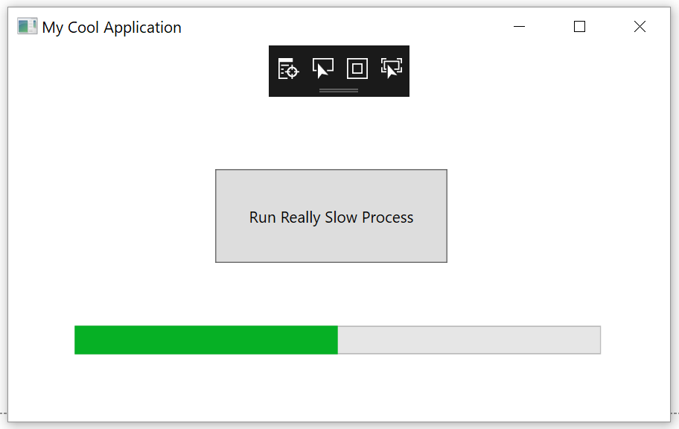
My History with Background Processing
Button -> Manually Triggering Job
Windows Scheduler
Windows Service
Azure Scheduler -> Azure Job
Azure Scheduler -> Http Endpoint
Azure Scheduler -> ServiceBus -> Azure Job
Hangfire
Notes:
Scheduling background jobs is something that every developer will come across at some stage.
I’m going to go through each one and give my opinion, your results may vary.
Don’t Cringe too much.
In the past I've used or worked on:
Manually triggering a batch job at the start of the day.
I have actually done this, in my defense it was for my own business and I never really got around to automating it.
+ Easy-ish to write you still need progress bars
- Annoying for the end user
-If it is web based… There is no feedback loop / session timeout issues for web based applications.
* Windows Scheduler (to trigger an exe)
- Double the Installation - Issues keeping your production / job code synchronized.
- Isntall manually? I think
- I just felt dirty
* Windows Service
- Installation is a pain in the ass
- Double the Installation - Issues keeping your production / job code synchronized.
- Its just a bit of a pain in the arse.
- Clever dll Reader. Sure you can write a clever scheduler that checks dlls in a directory that have a specific interface and execute them, feeling really cool while you do it, but your still crying on the inside.
* Azure Scheduler -> Azure Jobs / Function
+ Easy-ish Installation, there is a bit of dicking around with logging as its running in a separate process.
- Double the Installation - Issues keeping your production / job code synchronized.
* Azure Scheduler -> Triggering an http endpoint
+ Easy Installation
- Session timeout issues?
- Security issues
- Uses websites resources
- I felt dirty again
Azure Scheduler -> Azure Service Bus
- Complex, so god damn complex
- All the limitations of Azure Jobs
* Hangfire
+ Easy to install
- Uses websites resources
You can sort of see where this presentation is going.

Slide 5

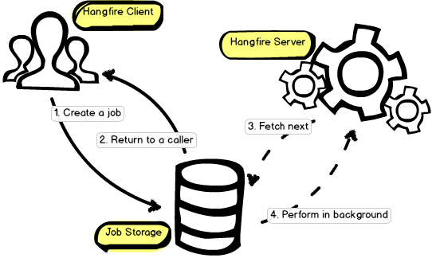
https://www.hangfire.io/
What is it? Simple scheduling
Uses your websites / apps resources
Open Source -> LGPL 3.0
.Net 4.5 and .Net core
Persistence: InMemory, SQL Server
or Redis (paid only)
Will scale out
Automatic Retry
IOC
Fun Fact: Stops free Azure tier sites going to sleep
Notes:
AM I TALKING TO FAST?
Hangfire, with my cool new logo.
What is Hangfire? Not much to it really…. It just does scheduling in a simple way!
You program it in your application, and it uses your websites / applications resources.
Negative to this is it may impact your websites performance with too many heavy jobs.
If that becomes a problem you can created a dedicated website / app to process the jobs.
The advantage of this over creating an azure function or webjob…. You are already deploying a website, now your just deploying 2.
Open Source -> you can use it for free LGPL 3.0. Use it for free, including it with your commercial applications.
Supports 4.5 and core.
Does anyone care about 4.5 anymore? Suckers.
Storage: InMemory, Sql Server, Sql Server Express, Azure Sql Database and Redis (paid version only)
It will scale out if you decide to run multiple instances of your website
Built in retry for jobs… Yay? I suppose it stops me writing some defensive code… Like that’s not what I do all day?
It uses your built in IOC so no need to get complex. Autofac + .net cores built in.
If anyone runs any free Azure sites, they can take a while to wake up, over the last week I’ve noticed that one running Hangfire just don’t go to sleep.
Door to door salesman
I will need to play with this a bit more to see if there is any real cost involved but it’s potentially a good hack.

Slide 6
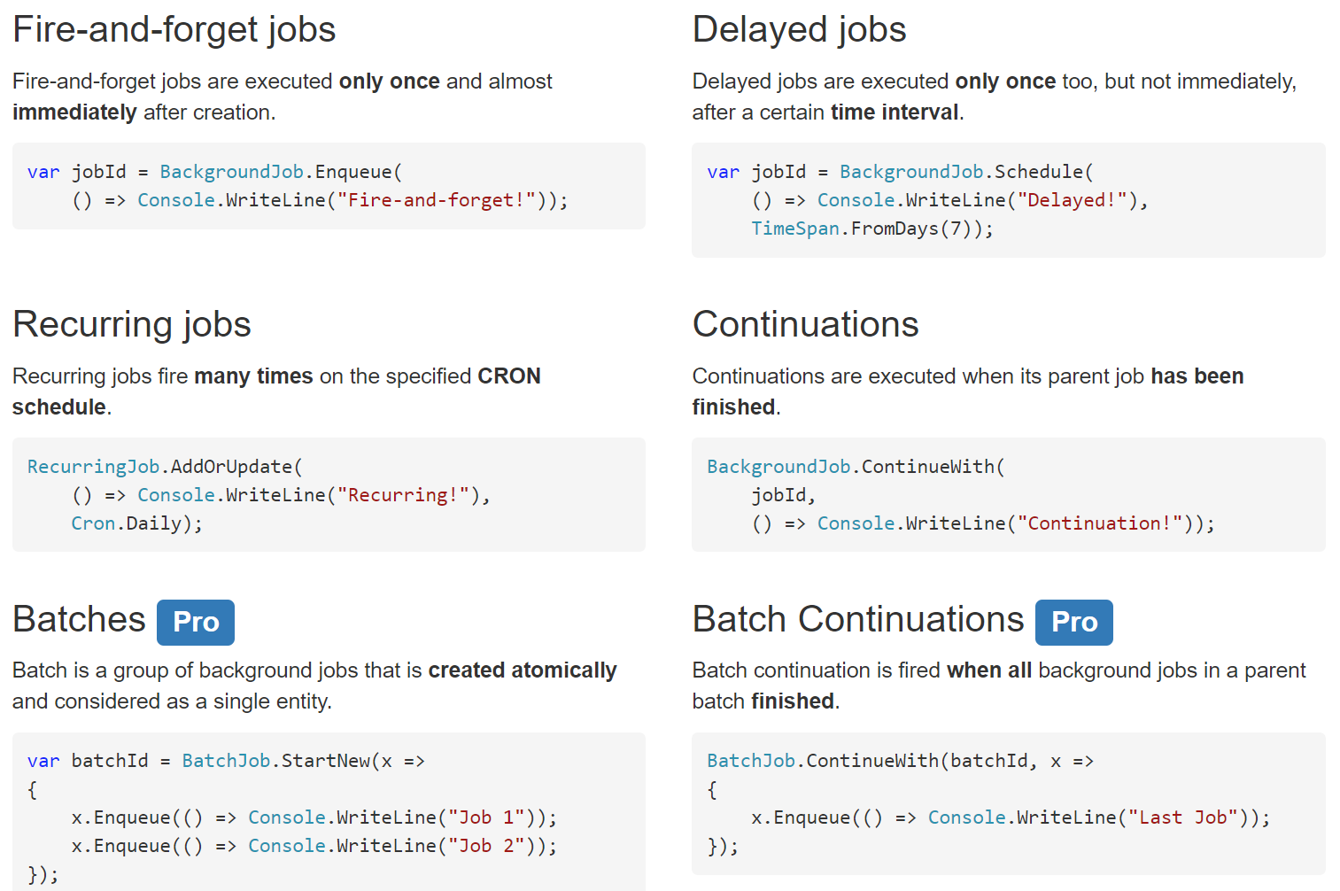
Hangfire – Job Types
Notes:
This is actually pretty cool.
Fire and forget Jobs -> Tell it to Just do it.
Delayed jobs… That could be cool, process new customers after hours, 24 hour cart reminders? Maybe give them a 10% discount code? Work out timezones so your not sending it in the middle of the night.
Recurring jobs -> The meat in a schedulers sandwich.
Continuations -> Because I want to put our complex business logic in a scheduler? I’m sure there are use cases for that, I don’t know.
Batch… Because I want to put our complex business logic in a scheduler. // I can’t afford that.

Slide 7
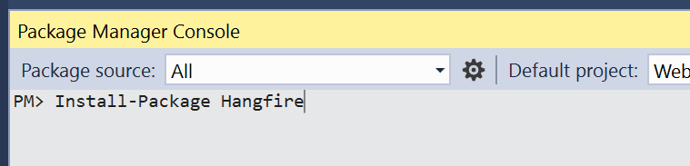
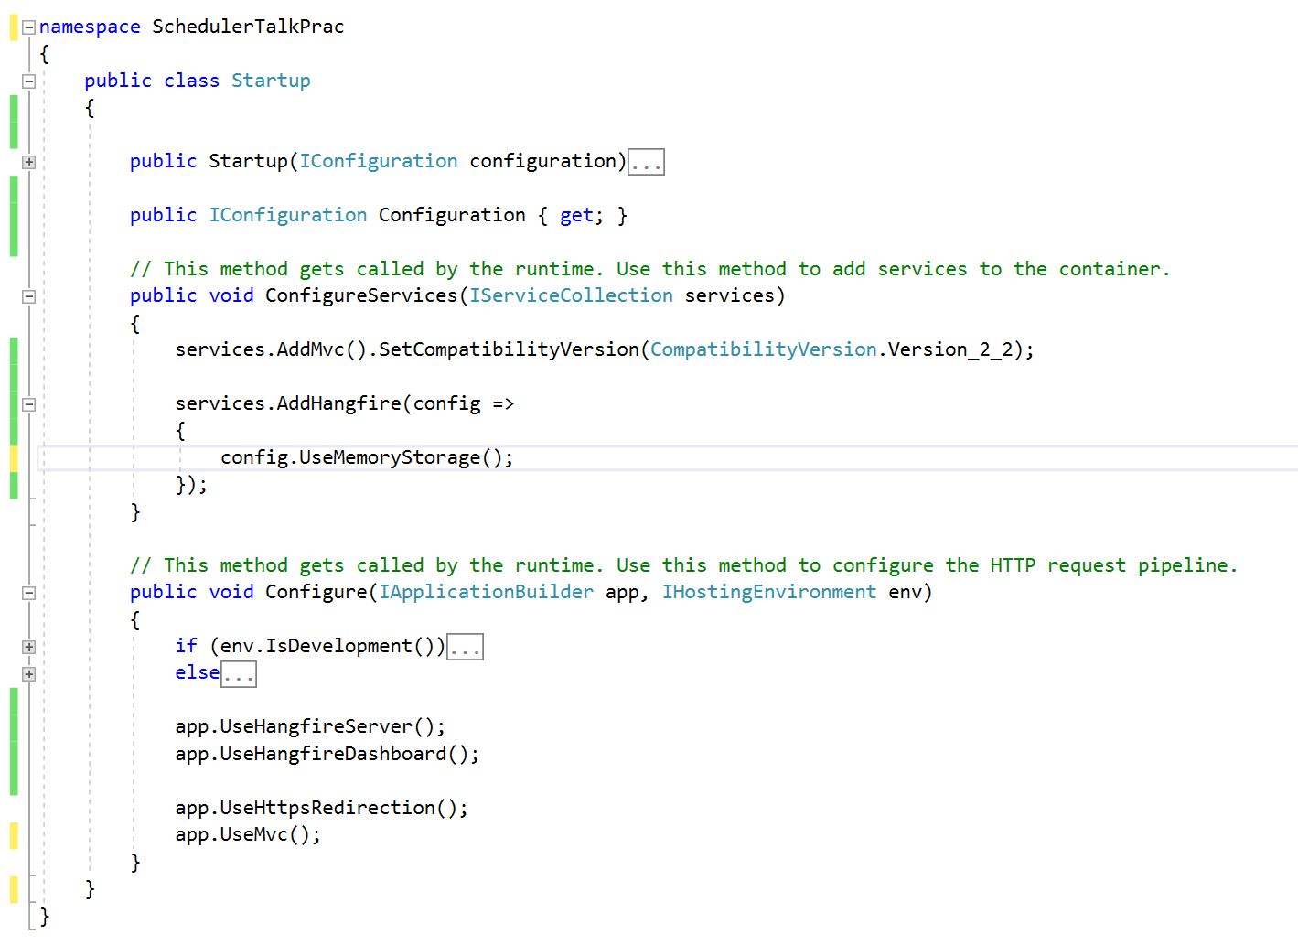
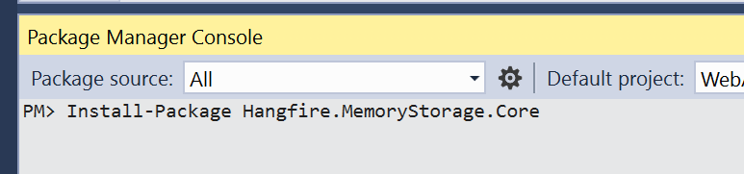

Hangfire Installation
Notes:
So Hangfire…. It is easy to install… Mostly. Once you dig into it the documentation can be a bit rough, but its pretty easy to google fu it.
So, we are using the in memory as an example because I don’t want to set up a database because I don’t have free Azure credits…
I know I can get azure free credits by creating a new account, but I’ve got a bit sitting on my main email. CBF.
So.
Install-Package Hangfire
Install-Package Hangfire.MemoryStorage.Core
In you ConfigureServices method in the Startup
services.AddHangfire(config =>
{
config.UseMemoryStorage();
config.UseConsole();
});
In your Configure method of Startup class add: app.UseHangfirefileServer(); ←this will start up your database or memory storage
App.UseHangfireDashboard(); ← this will give you the dashboard… default path is /Hangfire

Slide 8
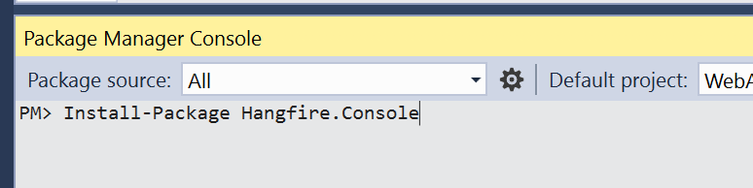
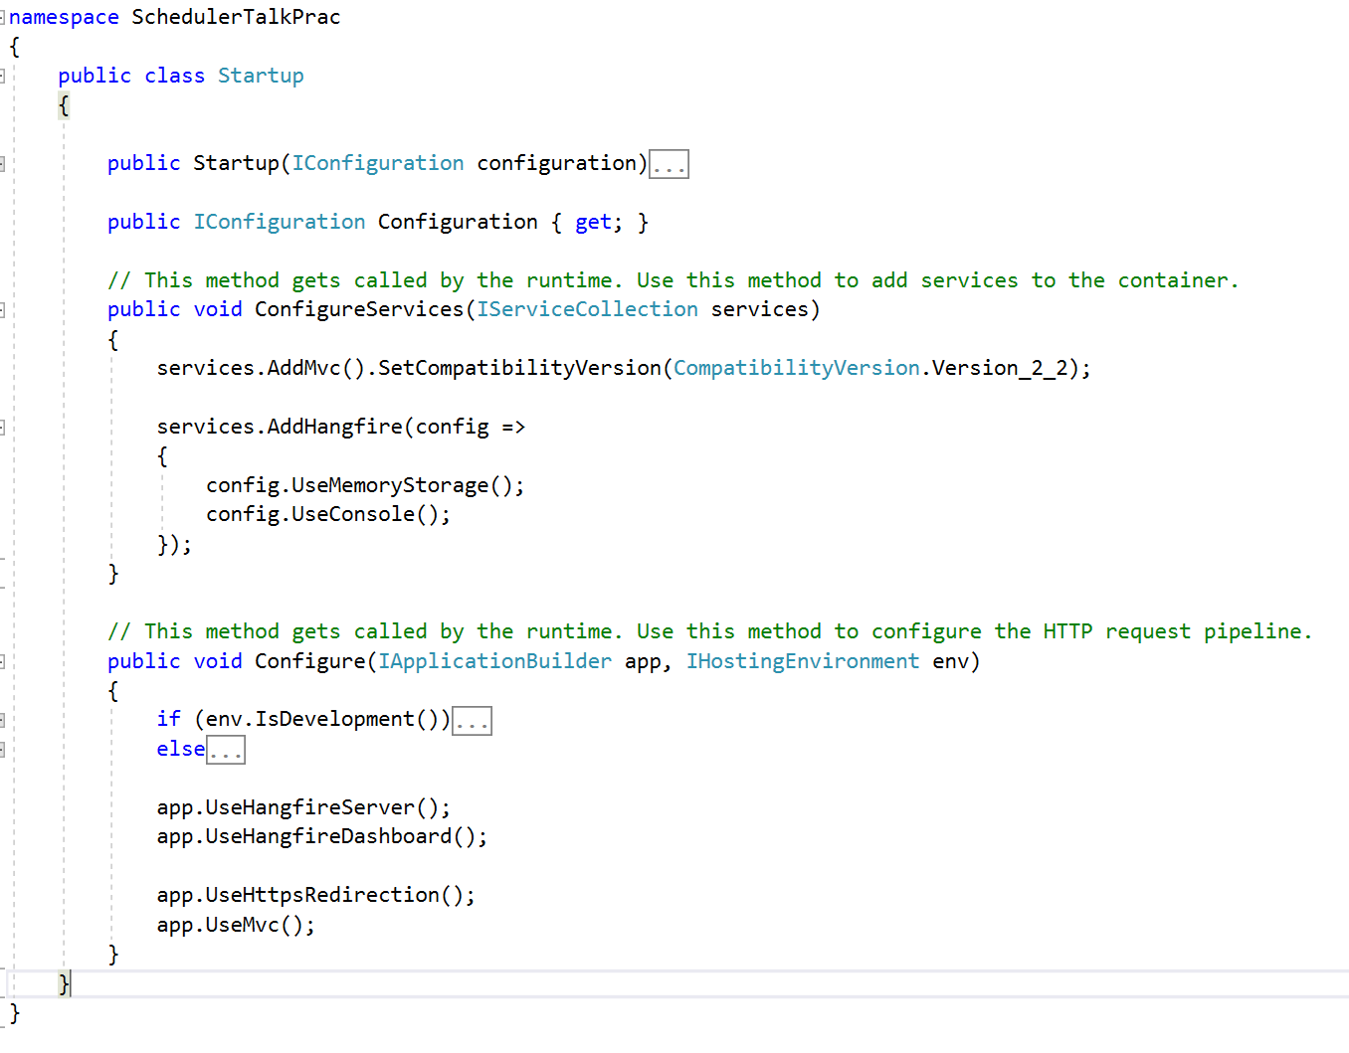
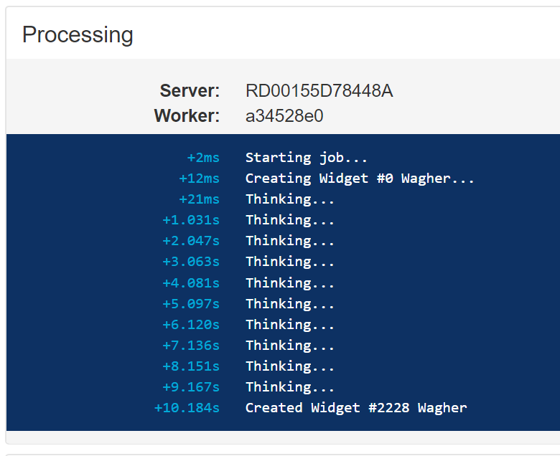


Hangfire.Console
Notes:
A nice side add-on to Hangfire is Hangfire.Console… Which gives you logs in your Hangfire dashboard…. But I am getting a bit ahead of myself.
So: Install-Package Hangfire.Console
And add to the ConfigureServices method:
Config.UseConsole();

Slide 9
Practice example…
Notes:
services.AddHangfire(config =>
{
config.UseMemoryStorage();
});
app.UseHangfireServer();
app.UseHangfireDashboard();
public class WidgetJob
{
public void Execute()
{
for (int i = 1; i <= 10; i++)
{System.Threading.Thread.Sleep(1000);
}
}
}
RecurringJob.AddOrUpdate<WidgetJob>(x => x.Execute(), Cron.Minutely());
------------------------------
config.UseConsole();
RecurringJob.AddOrUpdate<WidgetJob>(x => x.Execute(null), Cron.Minutely());
public class WidgetJob
{
public void Execute(PerformContext context)
{
for (int i = 1; i <= 10; i++)
{
context.WriteLine($"Doing stuff #{i}...");
context.WriteProgressBar(i * 10);
System.Threading.Thread.Sleep(1000);
}
}
}
--------------------------------

Slide 10
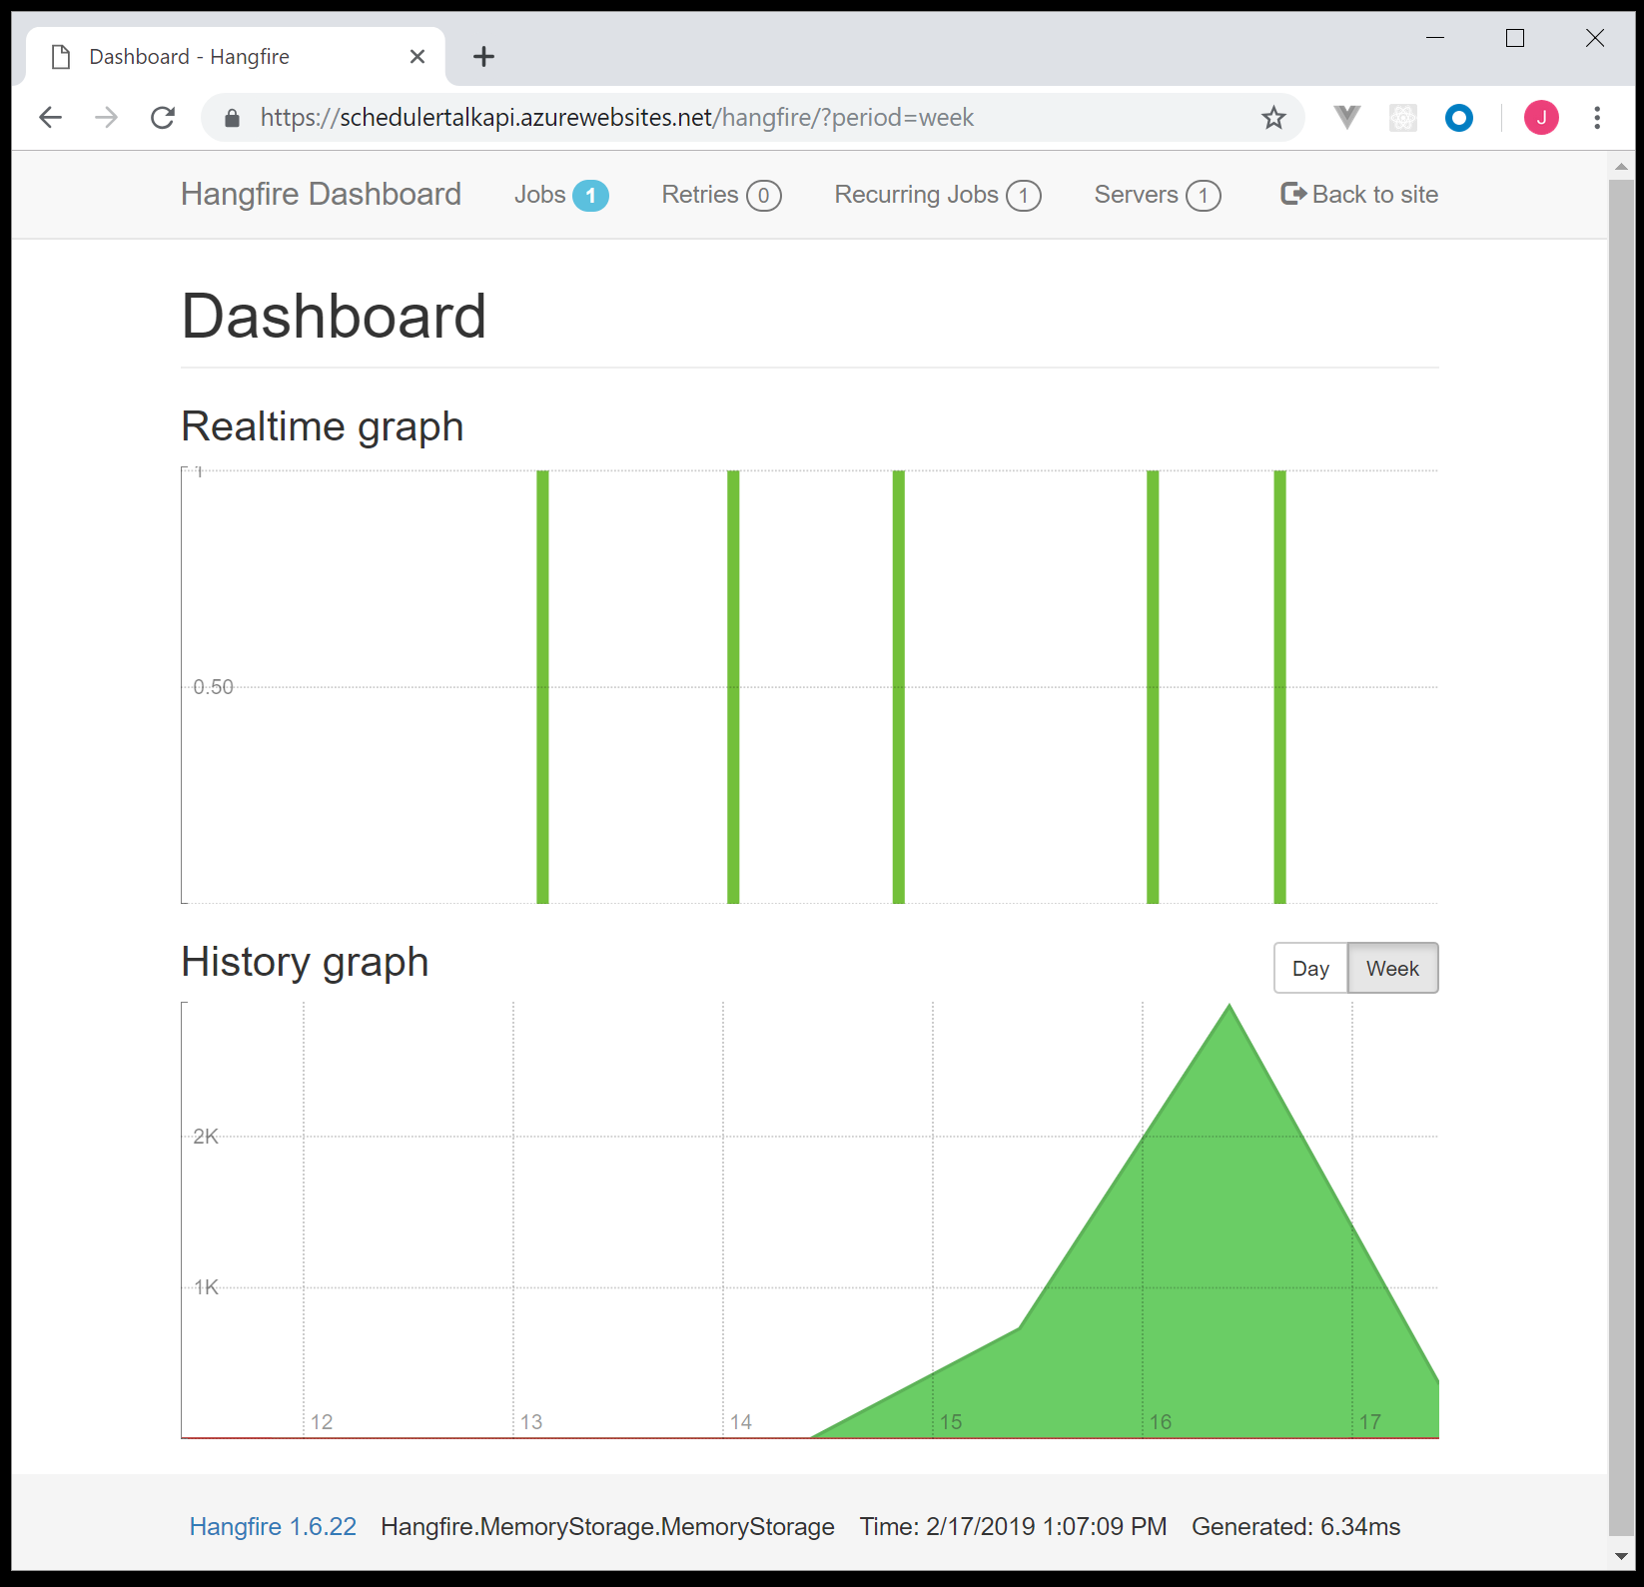
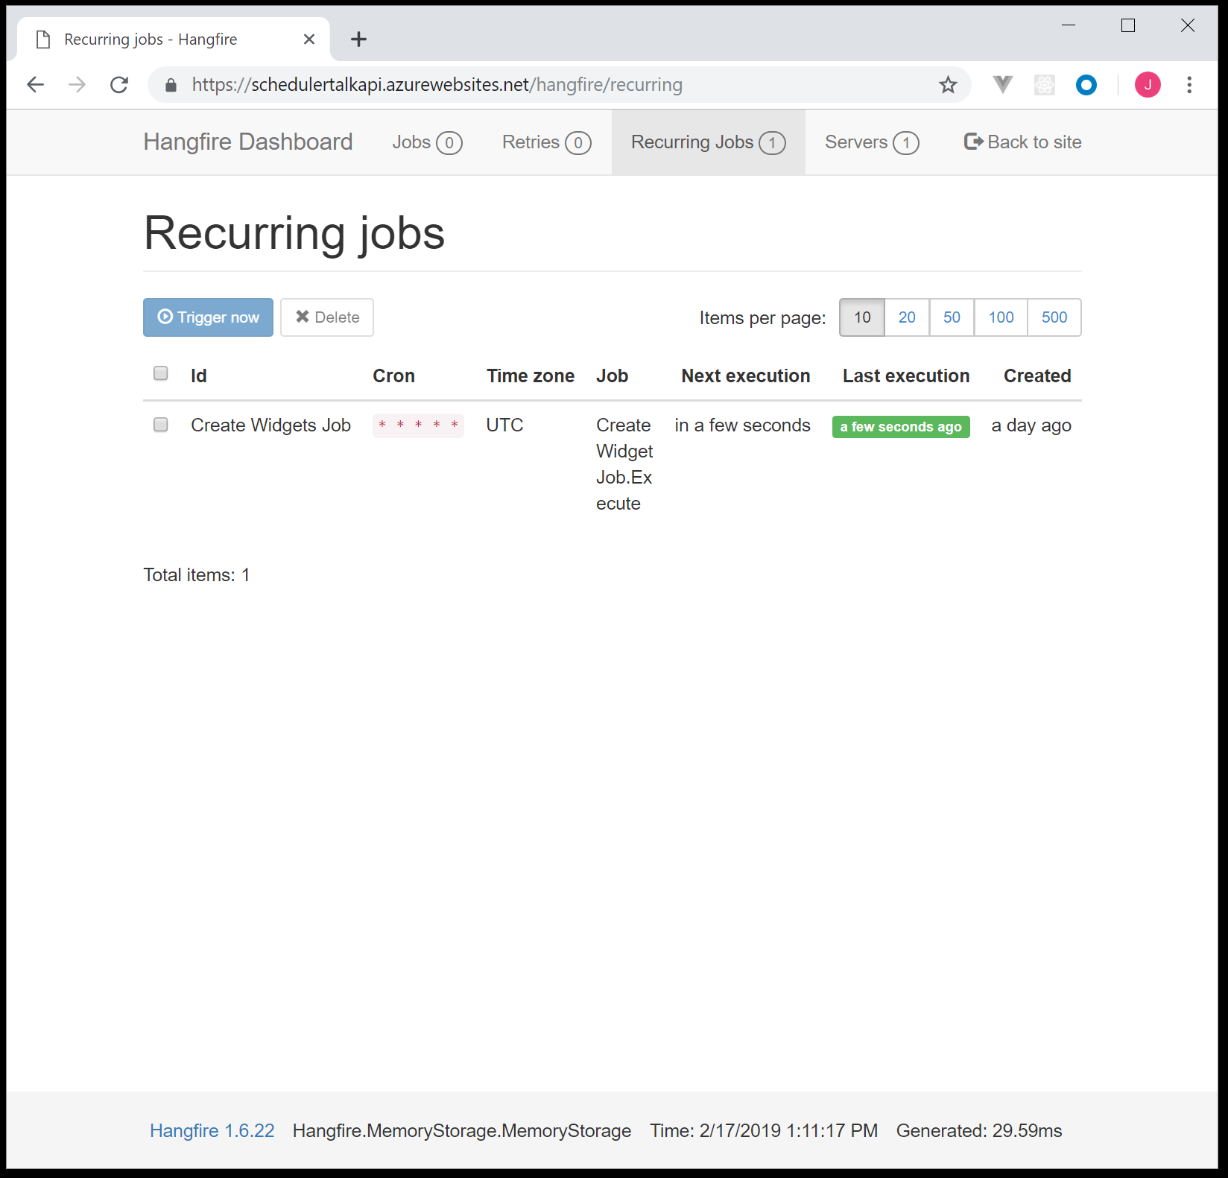
Hangfire Dashboard

Slide 11
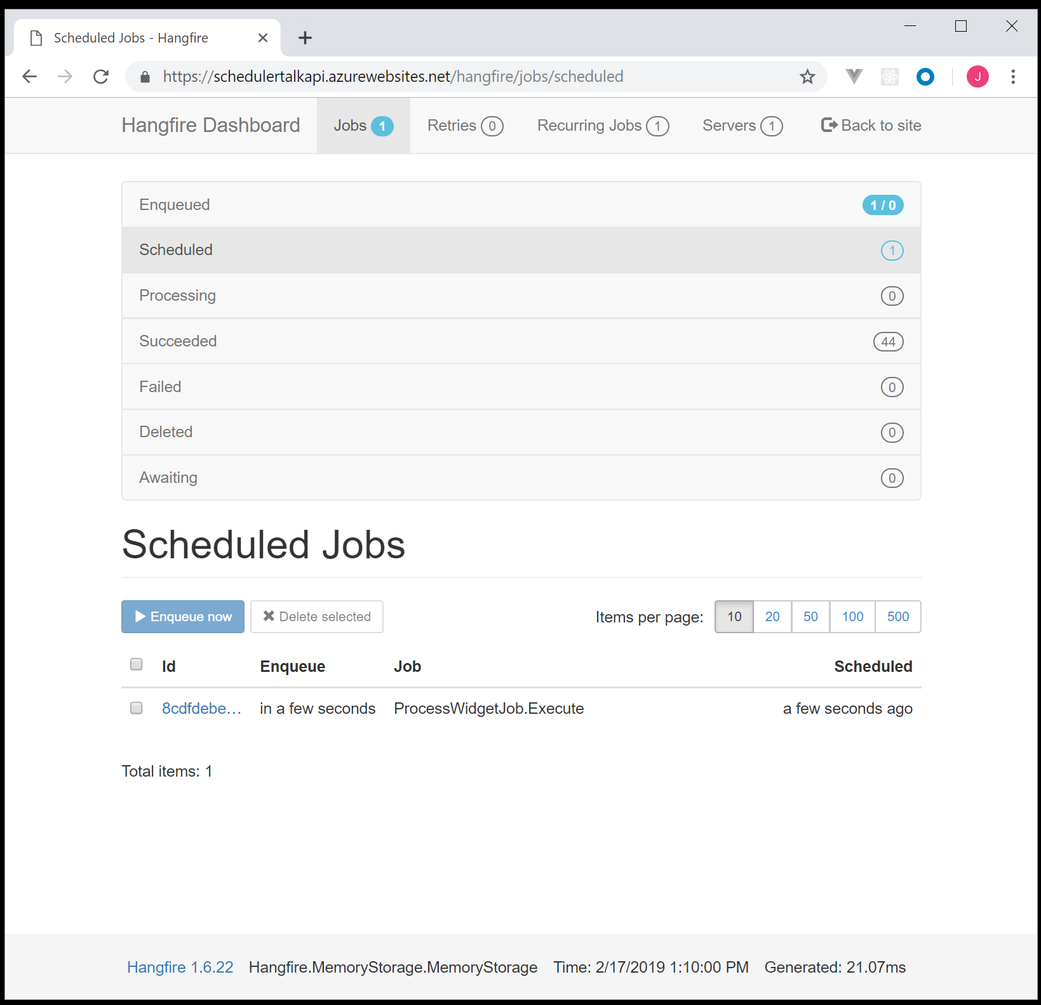
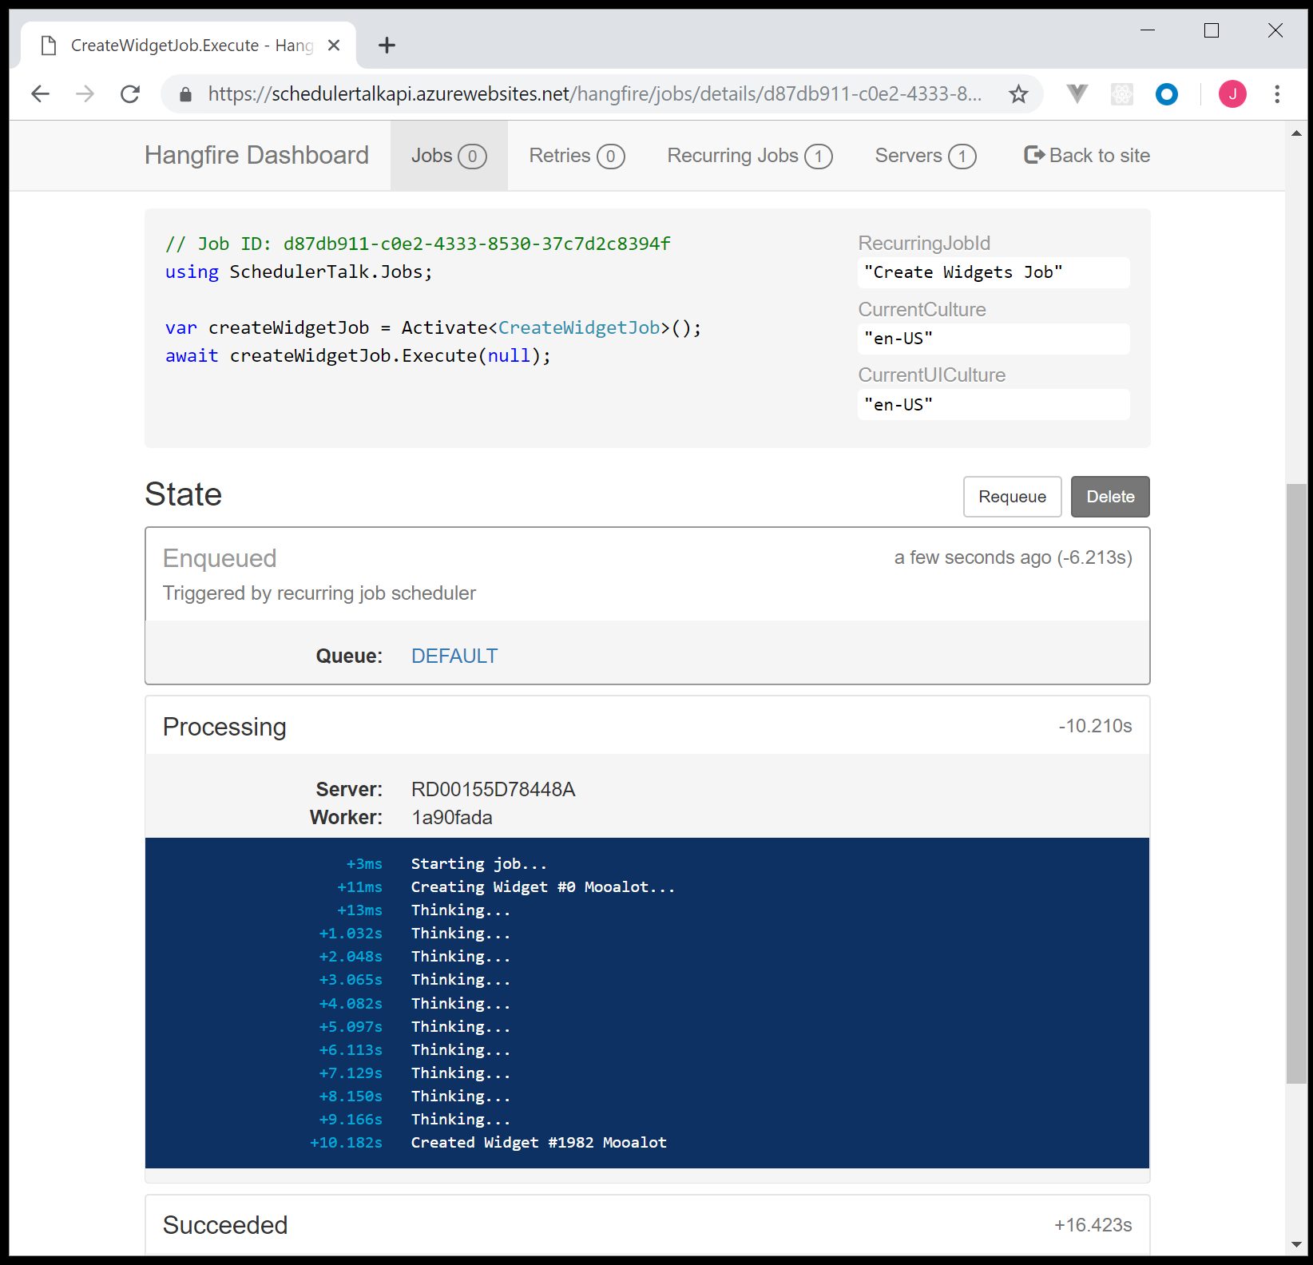
Hangfire Dashboard II

Slide 12
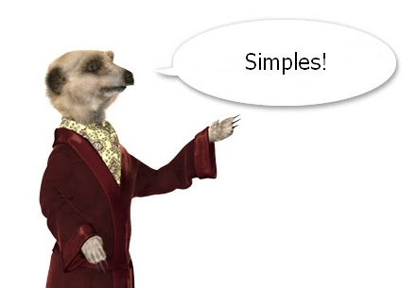
Notes:
Okay, we didn’t cover security. Exeption handling… Which isn’t rocket science and is covered in my github example.

Slide 13



Notes:
So we have seen who is in the left corner.
In the right corer, is Azure Logic Apss, Weighing in at 97 billion USD… But its all going to charity.

Slide 14

“In 2016, we launched Azure Logic Apps, which includes the ability to configure and run scheduled jobs as well as advanced workflow features other stuff.”
Microsoft Flow
Workflow engine
200+ Connectors (Integration)
Notes:
In 2016, we launched Azure Logic Apps, which includes the ability to configure and run scheduled jobs as well as advanced workflow features.
Microsoft Flow (I feel the need to apologies for the name). It’s apart of their Microsoft 365 sweet.
Marketing department
Workflow engine
200+ Connectors
Run a task, if it falls over, send an email, log a Jira bug etc… The possibilities are actually pretty amazing.
Its all in a drag and drop interface your managers can… Well they can bug you to help make them work as if you were using a real programming language.

Slide 15
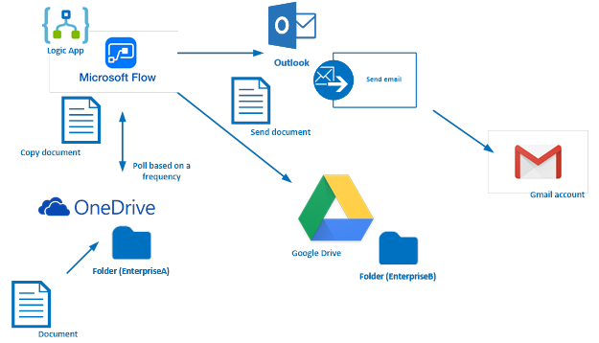
Azure Logic Apps
Notes:
"Automate many of the workflows you have in place, without writing a single line of code“
You could.
Upload a document to one drive. Copy it to Google Drive in a folder
Send an email using outlook to someone on Gmail…. It’s CRAZY

Slide 16

Microsoft Marketing 301
Notes:
Its so crazy I just cant begin to explain it, so instead Im going to make you watch this video.
Thoughts?
My thoughs are I couldn’t give a rats arse.
My boss is wriggling in his chair in excitement, and I hope he never reads this presentation.

Slide 17
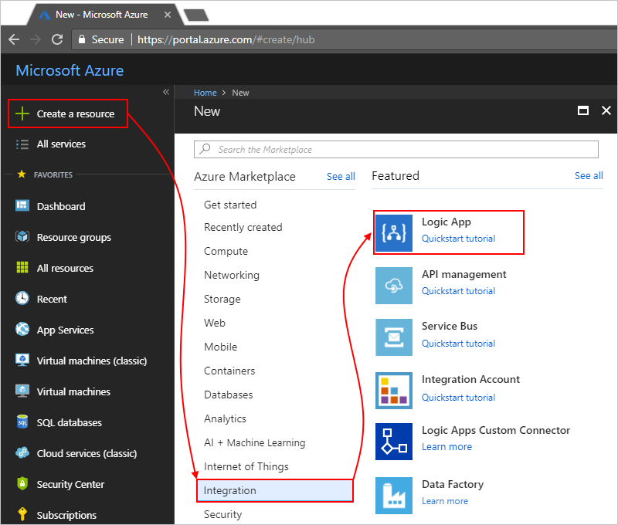
Creating a Logic App
Notes:
I don’t have an internet connection in this device so it’s all screen captures.
Some of the screen captures aren’t even mine.
So Login to Azure.
Create Resource -> Integration -> Logic App

Slide 18
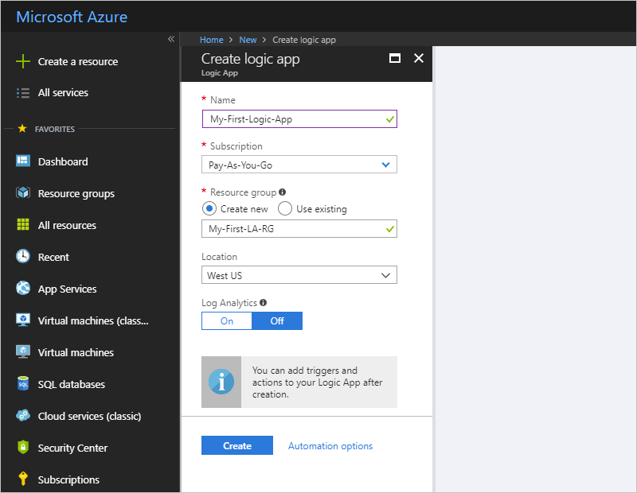
Creating a Logic App II
Notes:
This is a pretty standard interface for creating an Azure widget.
Being this the Gold Coast Azure / .Net Users Group…. Work it out yourself.

Slide 19
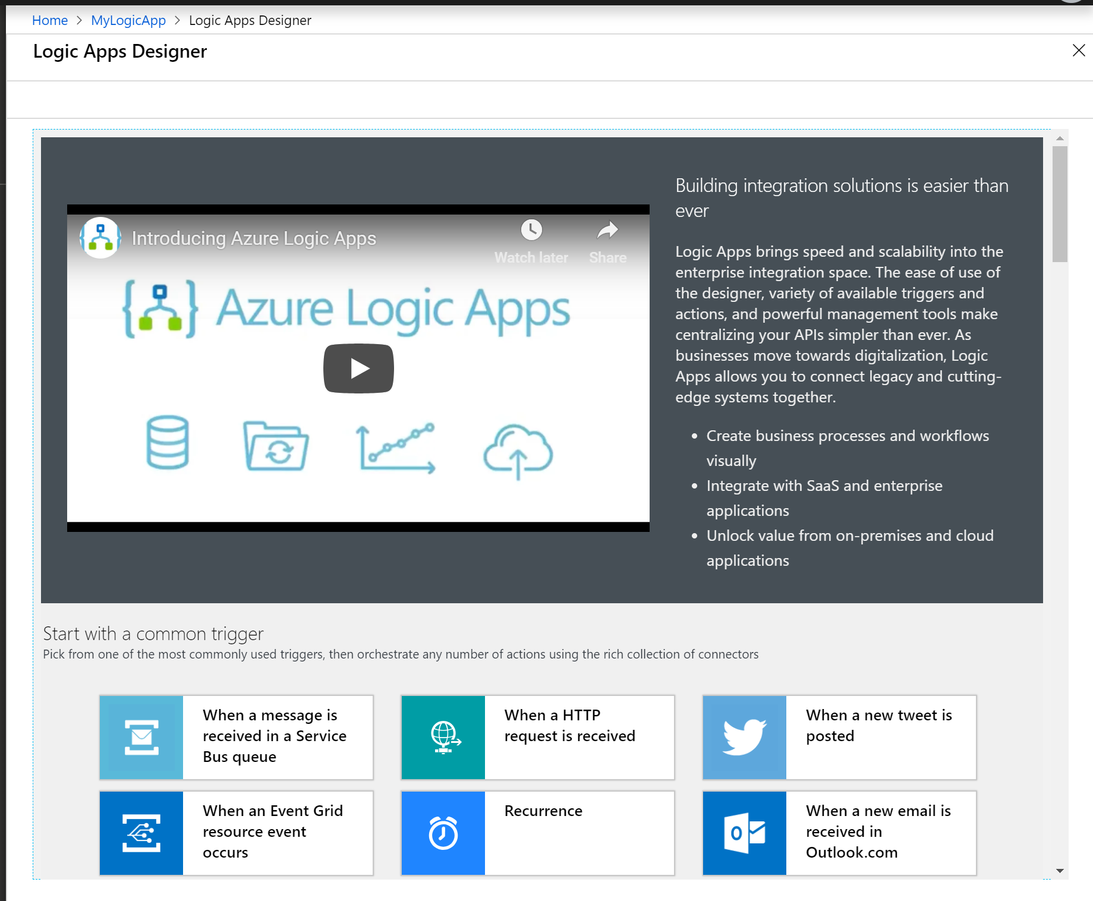

Create a Scheduled Job….
Notes:
It’s called a Recurence… Sure the alarm clock helps.

Slide 20
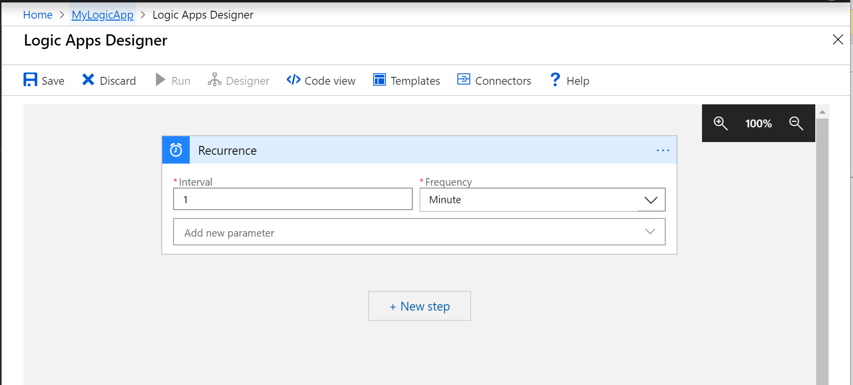



Workflow Designer
Notes:
Im not sure what resolution they are expecting every one to have. Im sure my boss has a 4k Monitor, he will use it fine.
Interval… 1 MINUTE! What was Azure Scheduler? 1 hour before you pay for it? Your paying for this, but its cheep.
1 minute Interval is approximately $0.10c a day.
Set your Interval
Set your Frequency
Next Step

Slide 21
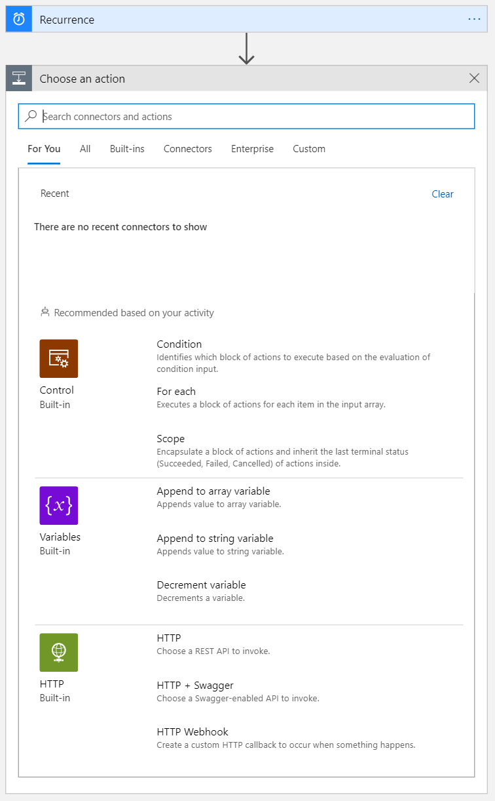
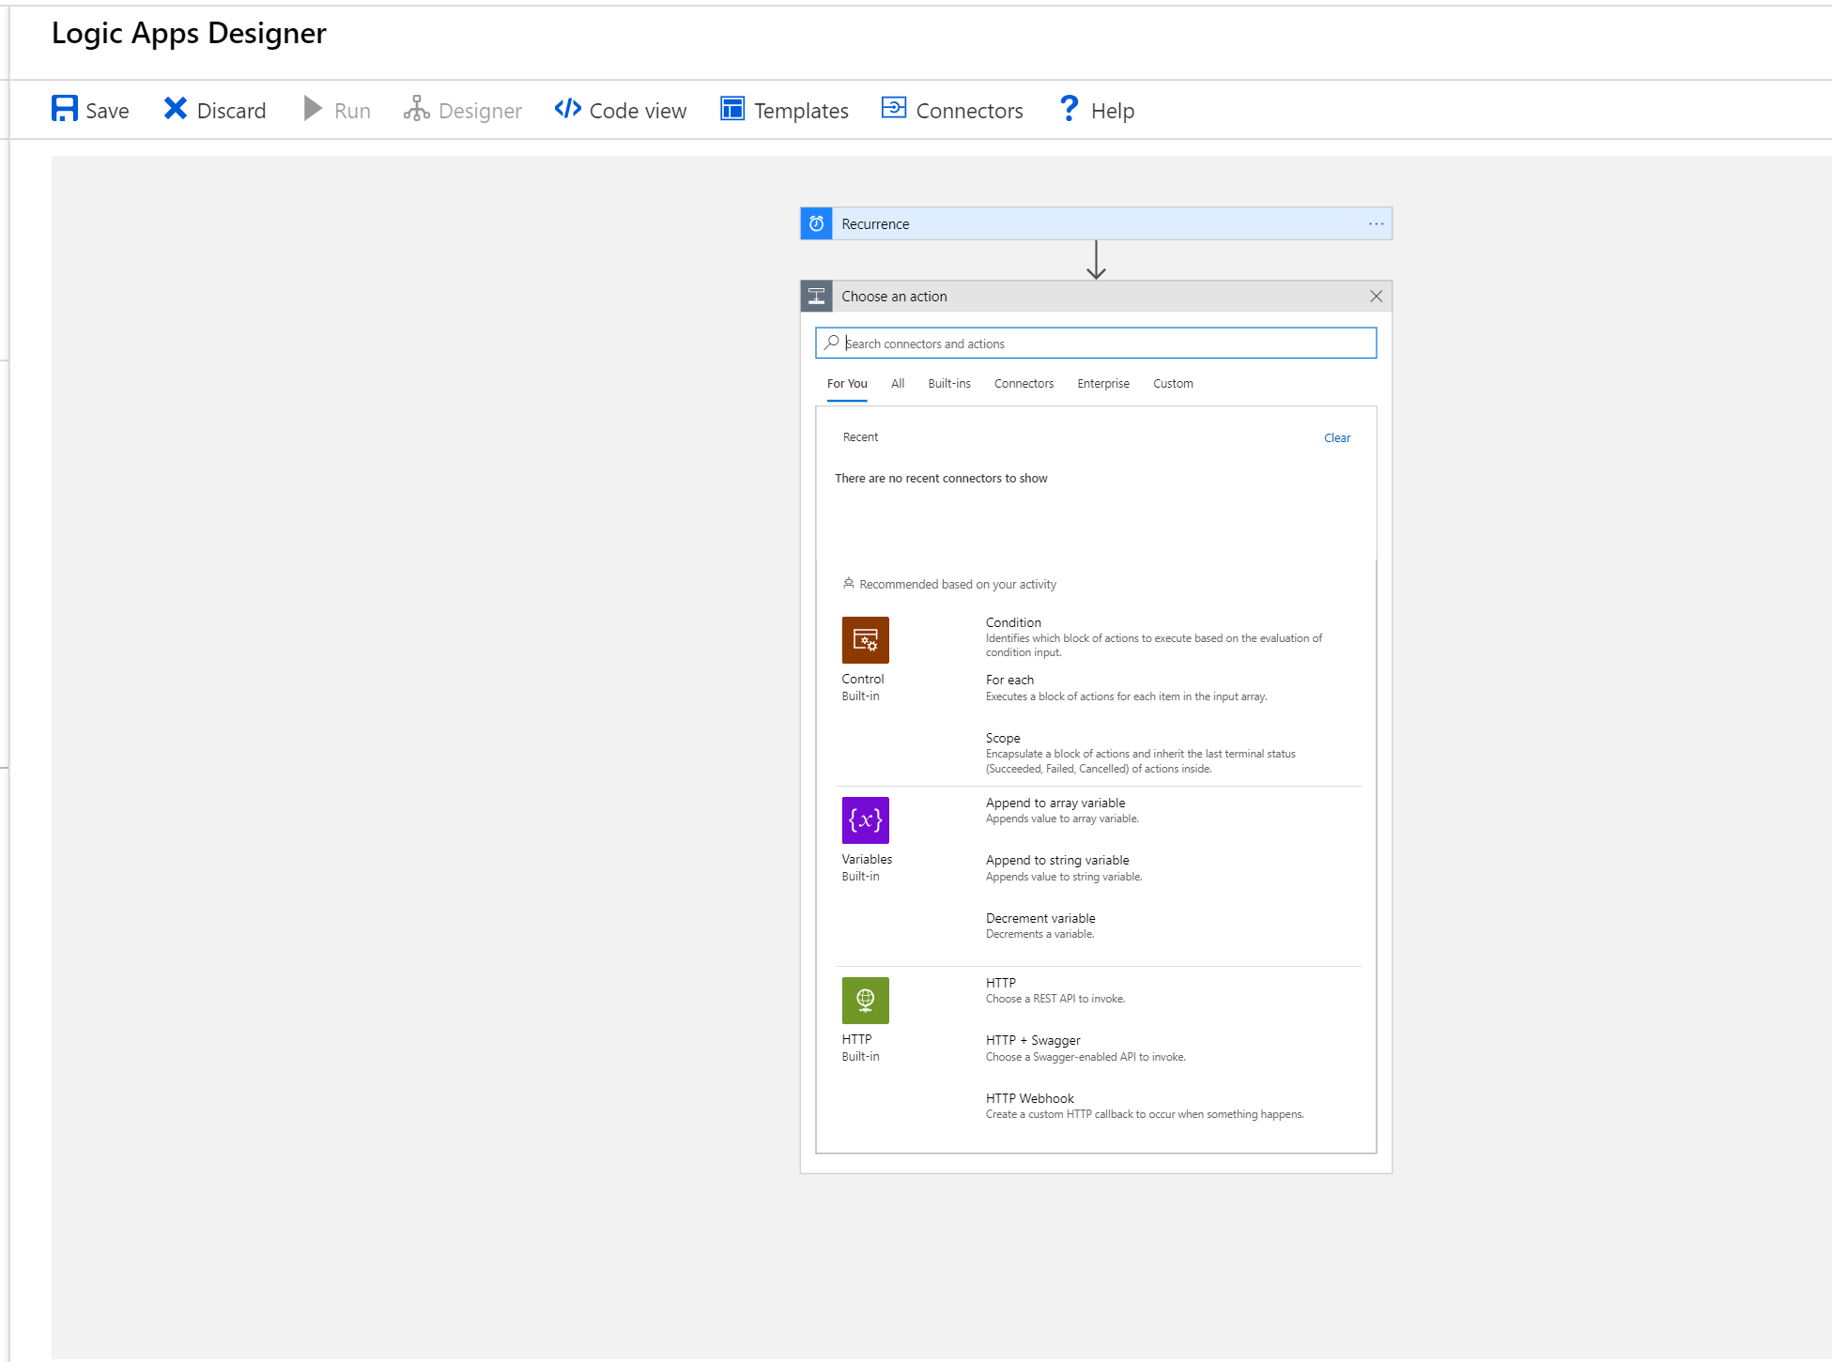
Select an Action
Notes:
Obviously lots of stuff you can do here.
Conditionals
Loops
Variables
Connectors (Integration)
Being this the Gold Coast Azure / .Net Users Group…. I’m sure you know what all that means.

Slide 22
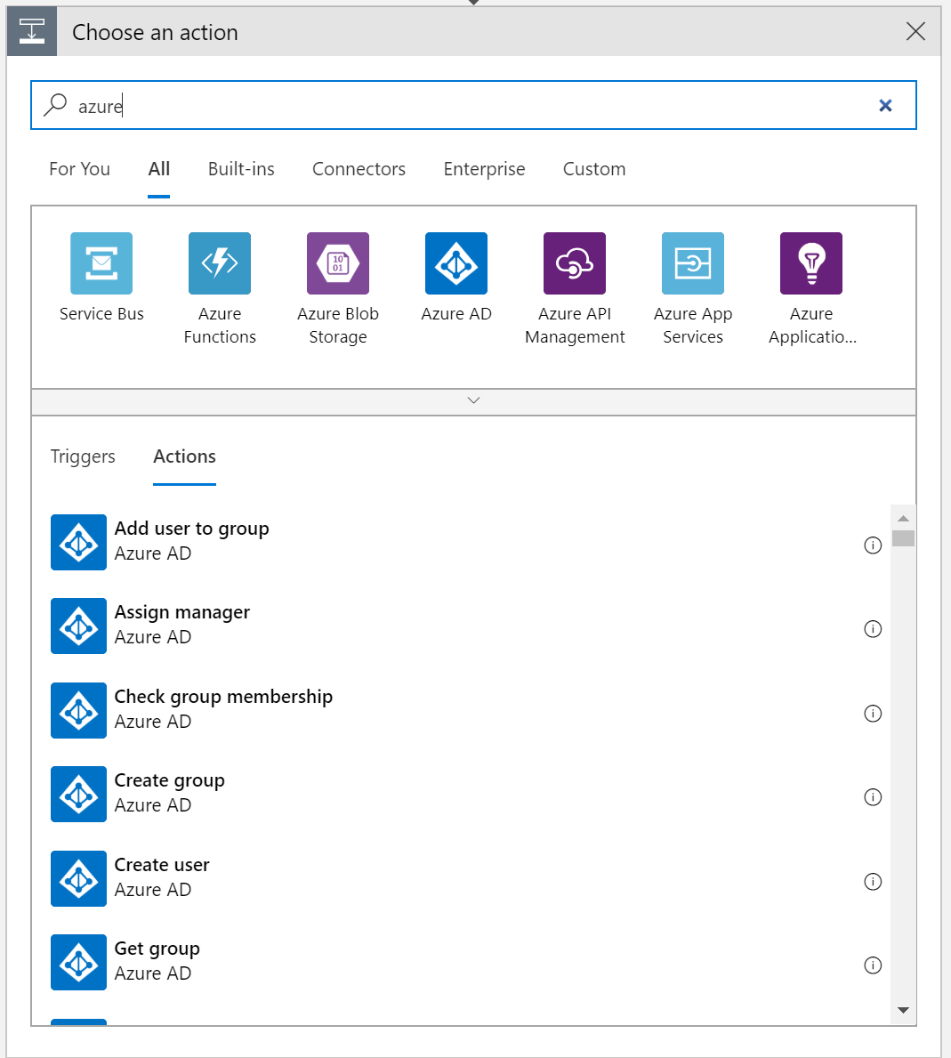
Select an Action II – Azure Jobs/Functions?
Notes:
Out of interest it does have Azure Functions, I didn’t see Jobs but I am sure they are there.
Limitations / Benfits

Slide 23
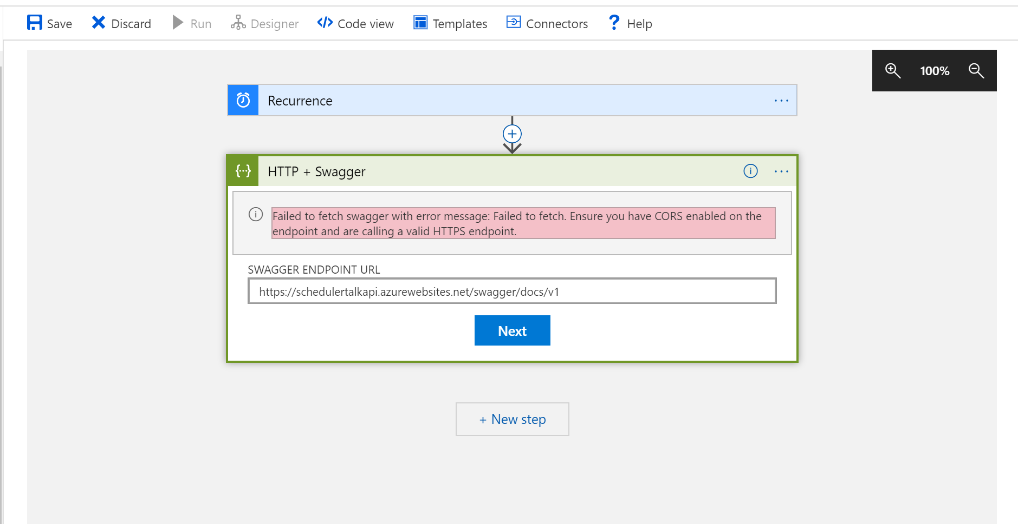
Select an Action III = SWAGGER!
Notes:
OMG It has swagger, I am such a fan!
Cors… I don’t have time for that.

Slide 24
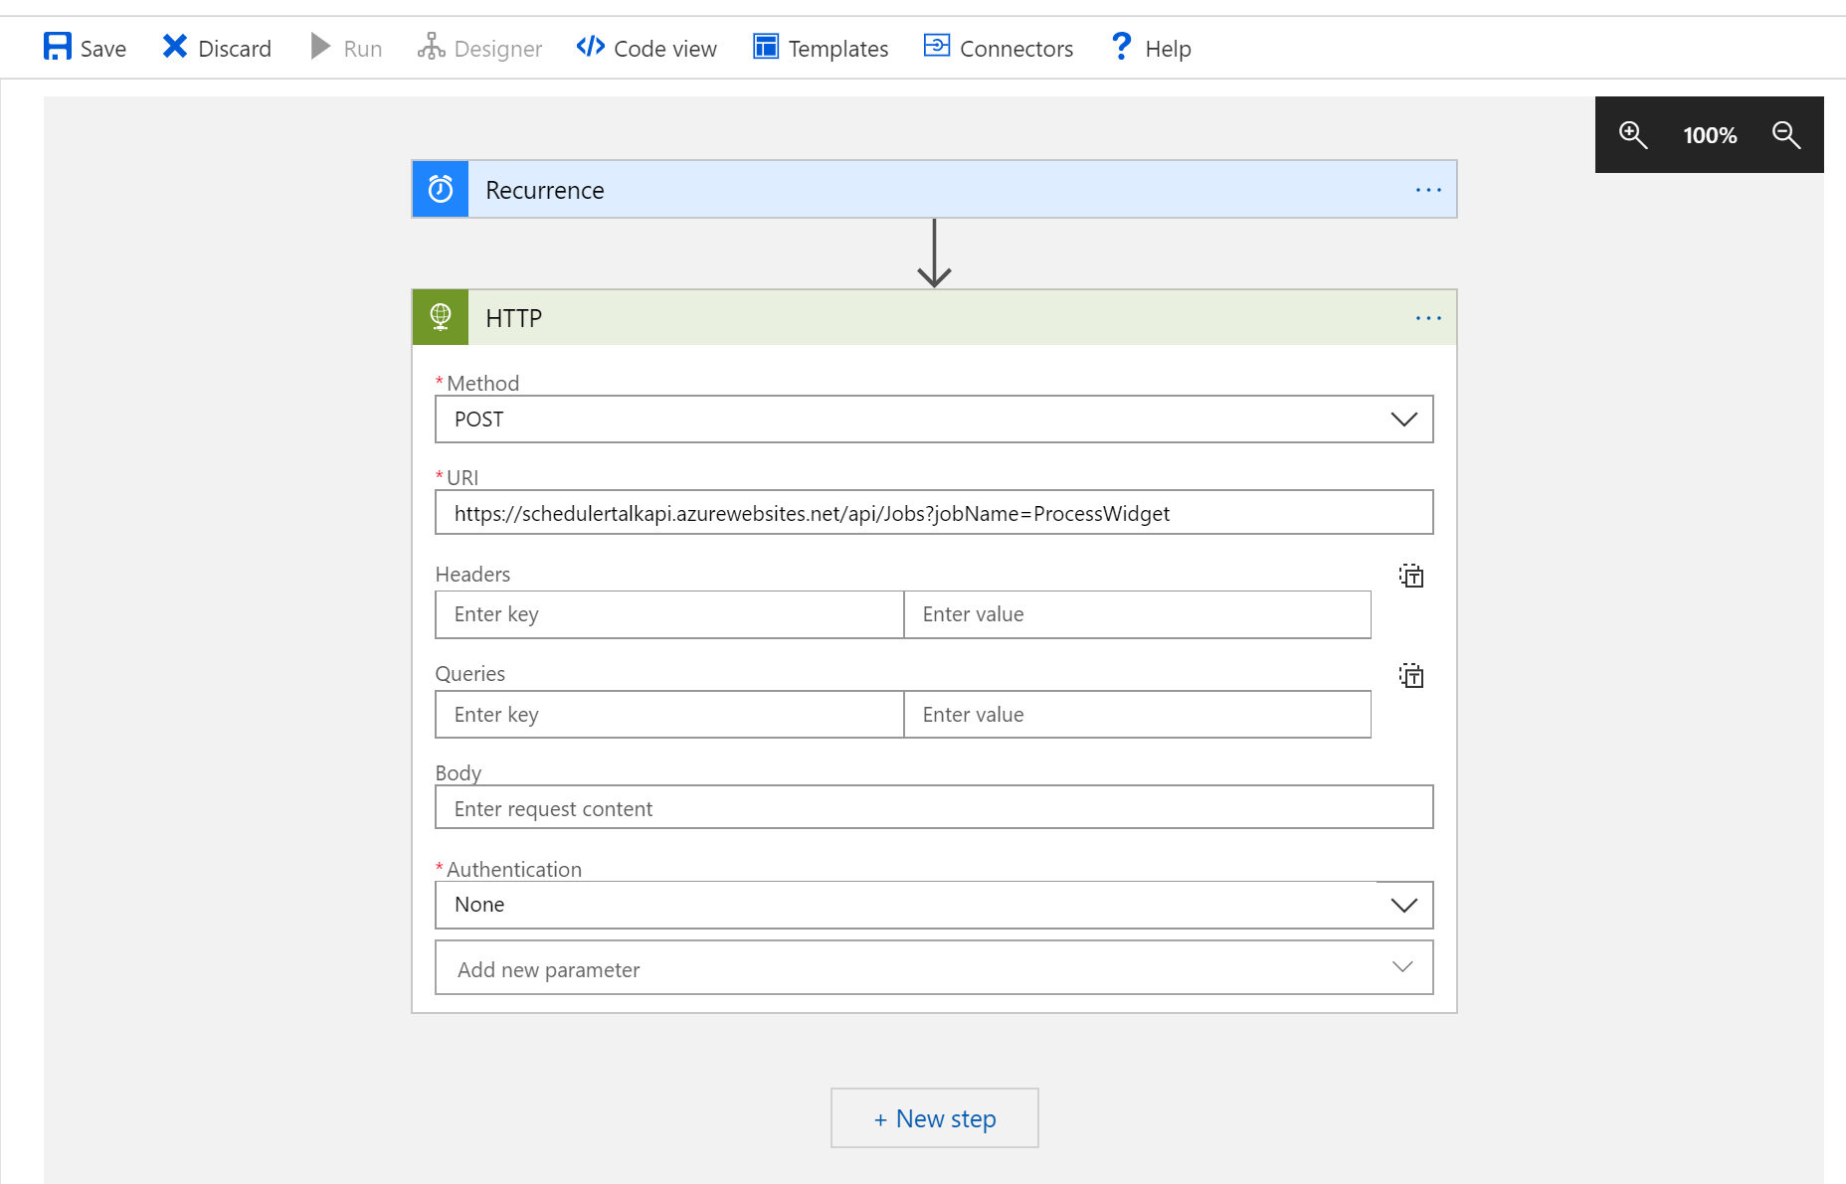

Select an Action = HTTP End Point
Notes:
HTTP End Point…. I know I know but the food is almost ready.
Rest Method.

Slide 25
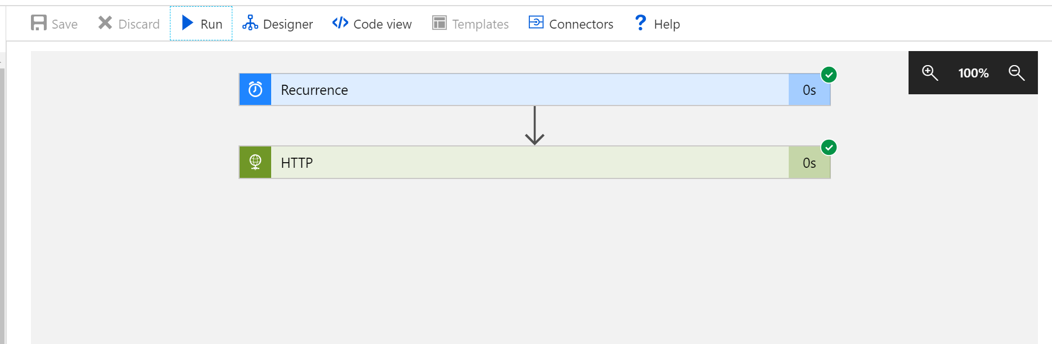

Run a Job
Notes:
Hit Run
And you get this, really uninspiring response.
Weird, the HTTP End point took 10 seconds but its reporting that it was instant….
That’s not very exciting.

Slide 26
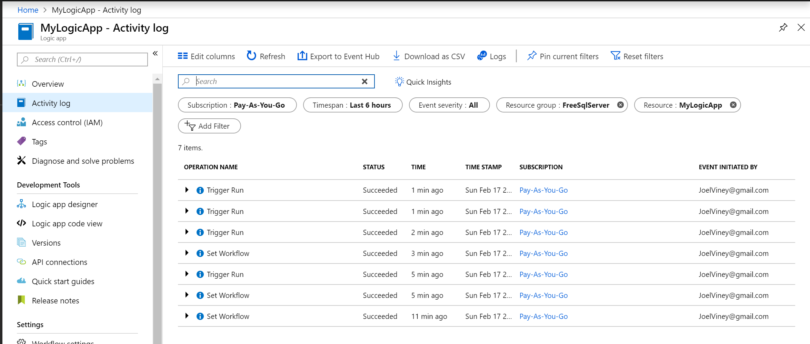
View the Activity Log
Notes:
Here you can see the activity log of your calls.

Slide 27

Azure Logic Apps… Okay?
Azure Scheduler was simple.
Azure Logic Apps Baggage
Land Grab by Microsoft?
Notes:
Okay, so where does this leave us?
Scheduler was simple. Will it be missed?
This wasn’t really complex. But it comes with a lot of baggage. As developers do we really care? Or will we get sucked in by the ability to log Jira calls when a Job fails?
This seems like a bit of a land grab by Microsoft, but at the wrong target. I don’t know.
There are some cool features in there. It might save you having to write a dodgy integration.

Slide 28
Summary
Some of the historic options for scheduling
Hangfire
What is it
How to Install it
How to use it
Pretty Dashboard
Azure Logic Apps
OMG what is it
How to use it
How much does it cost me?
Do I need all that stuff?
Notes:
Verbatim

Slide 29
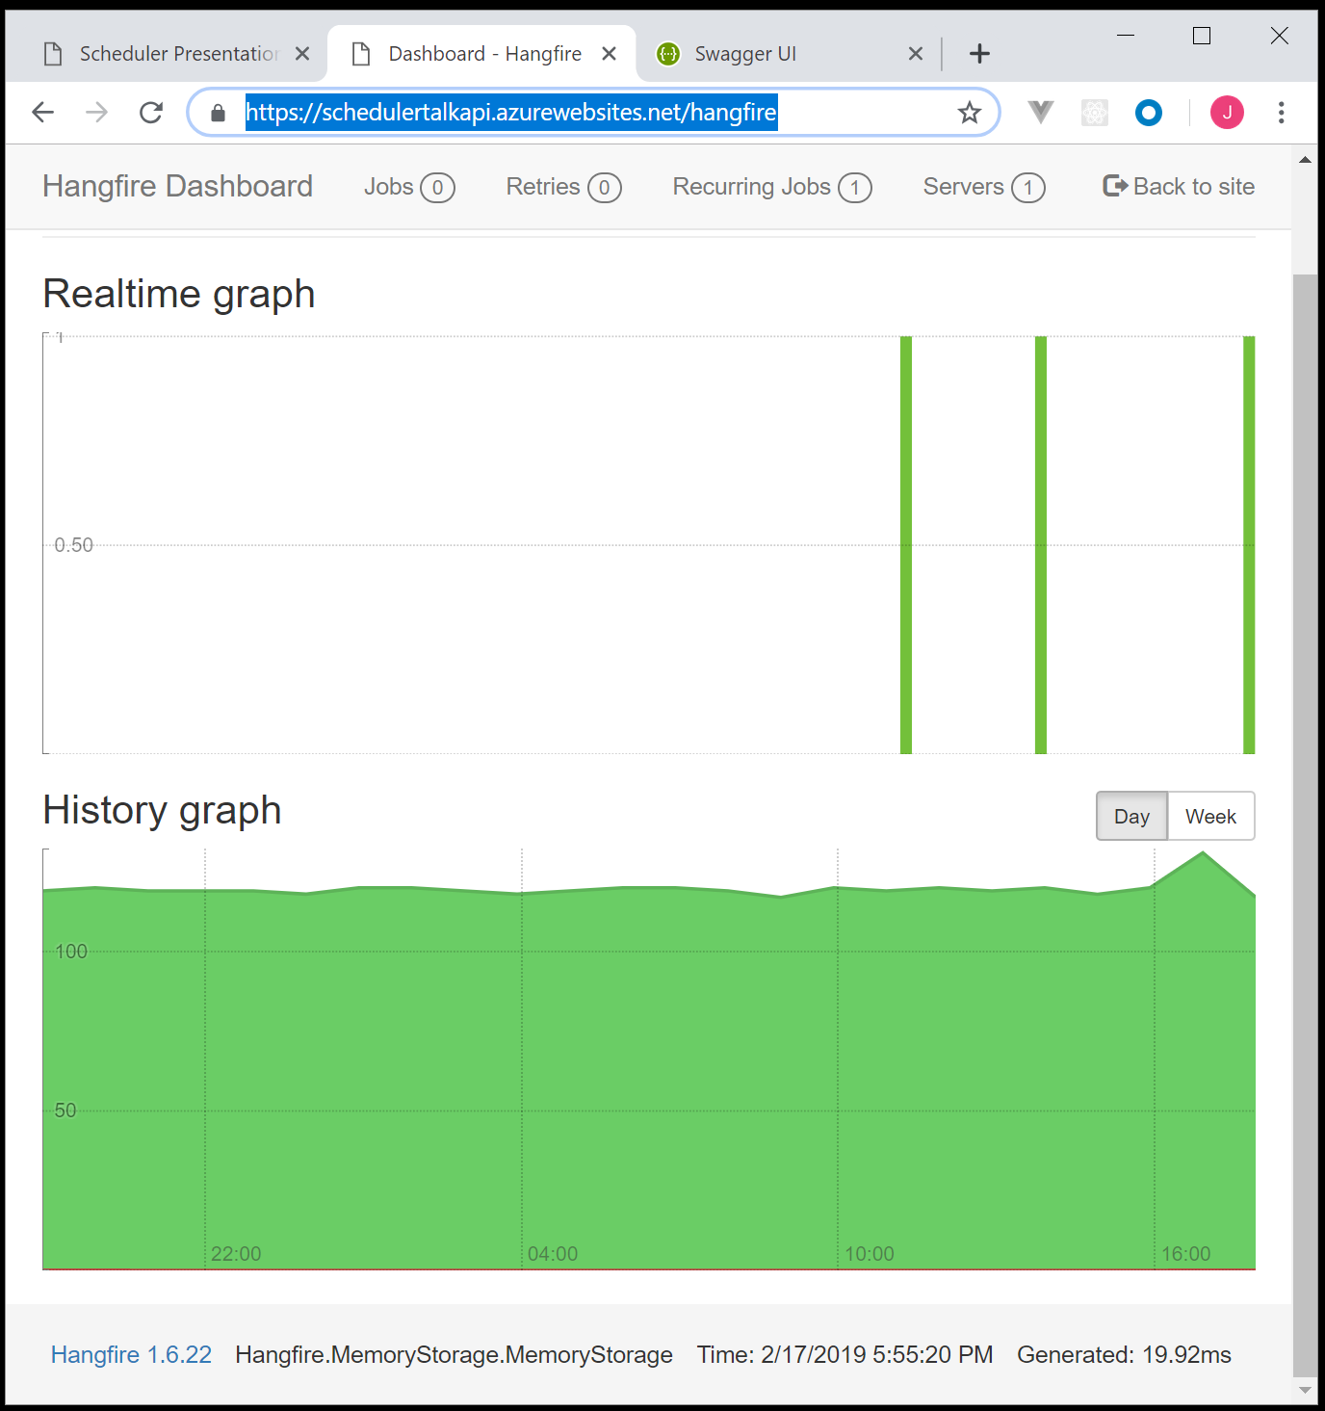
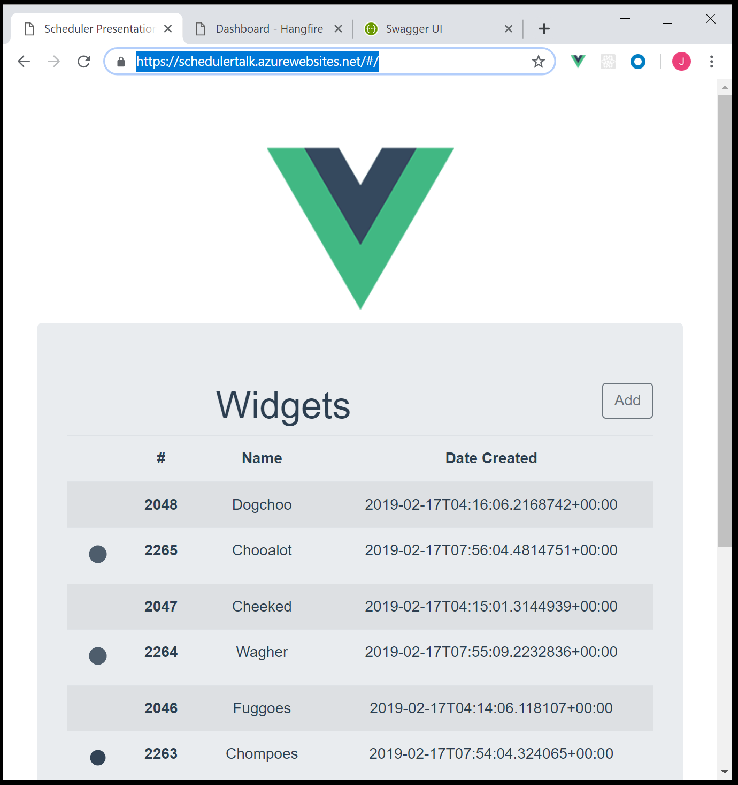
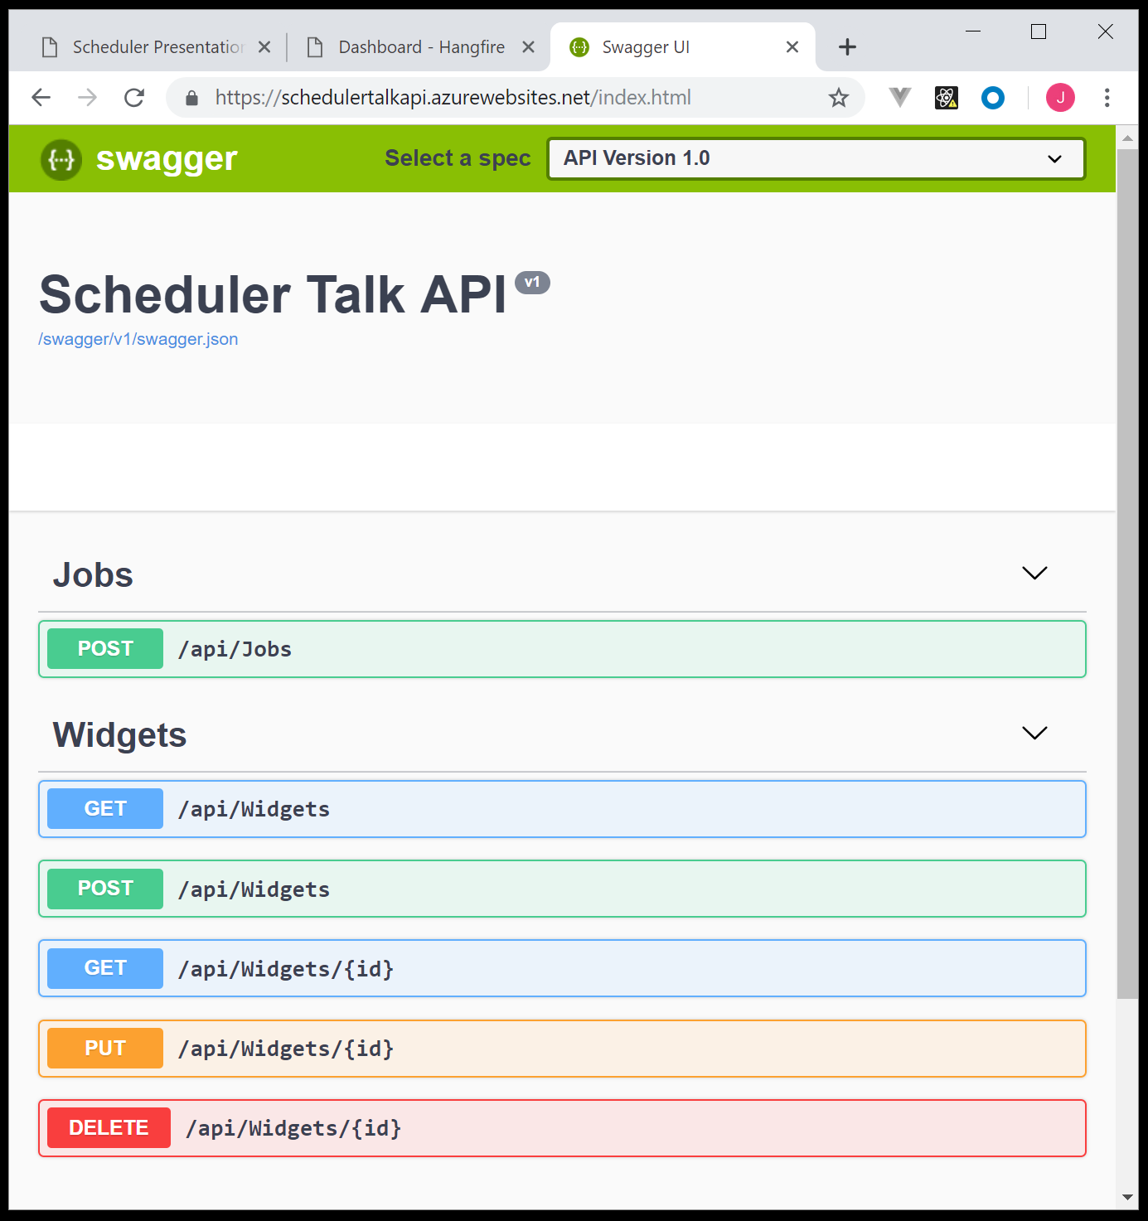
Github Example
Net Core API, Hangfire, Azure, Vue, SignalR, Nlog
https://github.com/JoelViney/SchedulerTalk
https://schedulertalk.azurewebsites.net/
https://schedulertalkapi.azurewebsites.net/hangfire
Notes:
So if anyone is interested I have a Github example up using Hangfire, Vue, SignalR and Nlog.
As well as this presentation.

Slide 30
Thank you
Hangfire and Hangfire.Console
https://www.hangfire.io/
https://github.com/pieceofsummer/Hangfire.Console
Azure Logic Apps
https://azure.microsoft.com/en-au/services/logic-apps/
Notes:
Thank you.

